Slide 1

Industrial gas leakage monitoring system
JNTUH College of Engineering Manthani
Centenary Colony, Pannur(V), Ramagiri(M), Peddapally(D), Telangana-505212.
Department of computer science
Team Members
N.Prathul Sai(16VD1A0523)
B.Akhila(16VD1A0502)
D.Sai teja(16VD1A0538)
S.Navaneetha(16VD1A0519)
Under the guidance of
Mr.Y.Satyam
Asst.Prof(c)

Slide 2
Contents
Introduction
Problem Statement
Literature Survey
Existing Solution
Demerits
Proposed Solution
Design
Outcome
Conclusion

Slide 3
Introduction
Detection of poisonous gases in industries using cheap and reliable IoT sensors.
Preventing human, materialistic losses.

Slide 4
Problem Statement
Gas leakage in the industrial area causes many health issues. Every year there has been recorded no of deaths causing harm to humans as well as animals and birds.

Slide 5
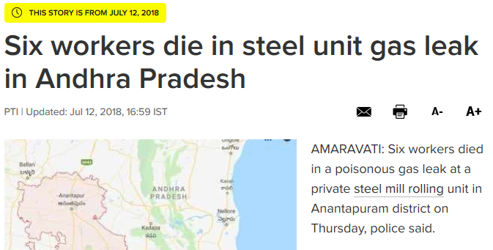
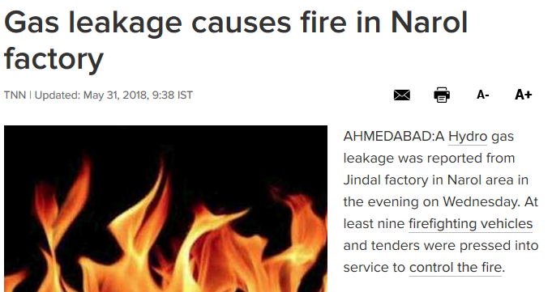
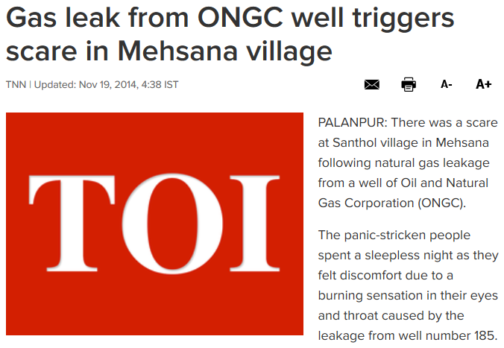
Literature survey

Slide 6
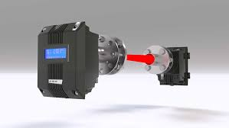
Existing Solution
Gas detection with laser
Robotic insects

Slide 7
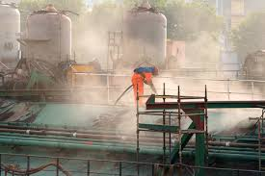
Demerits
When heavy dust , steam or fog blocks the laser beam , the system will not able to take measurements.
This method is very costly so it is always ignored by small scale industries.

Slide 8
Proposed Solution
A monitoring system for gas leakage detection needs to be developed with the combustible gas sensor (MQ9) was used to detect the presence of methane (CH4) and carbon monoxide gas (CO).

Slide 9
Design
Components required
Nodemcu
MQ9 sensor
Bread board
Buzzer
Jumper wires

Slide 10
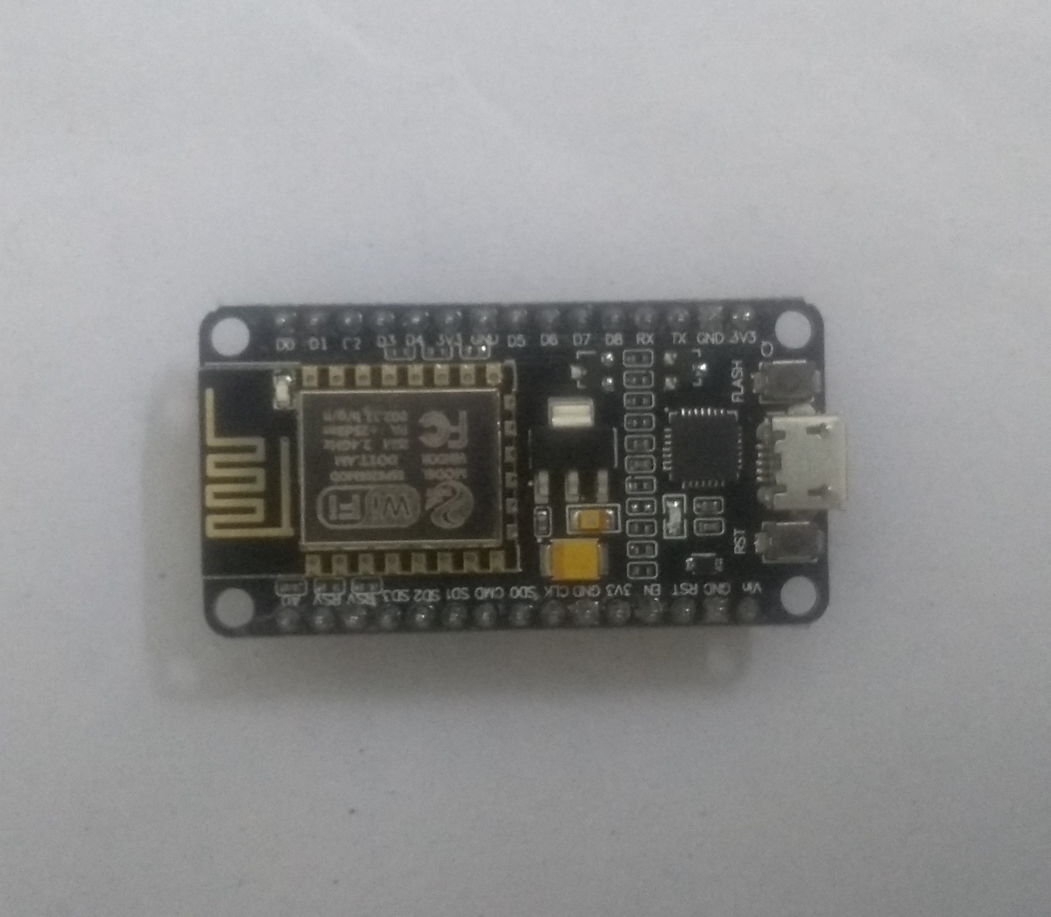
NodeMCU is an open source IoT platform. It includes firmware which runs on the ESP8266 Wi-Fi SoC from Espressif Systems, and hardware which is based on the ESP-12 module

Slide 11
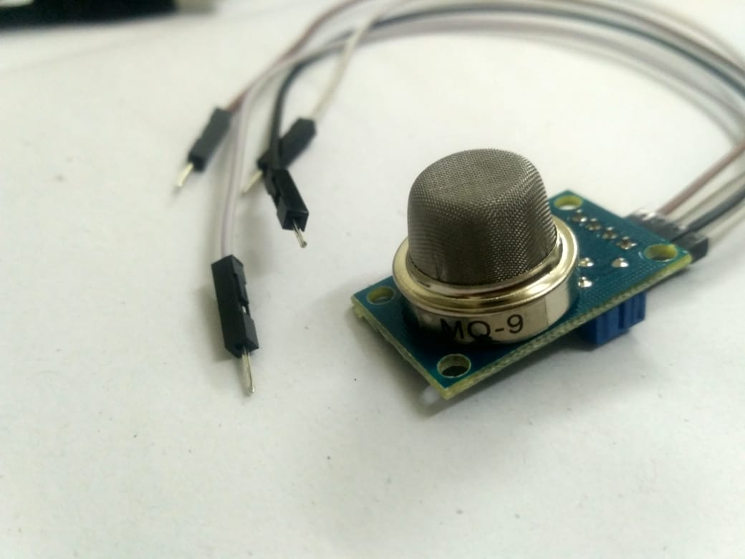
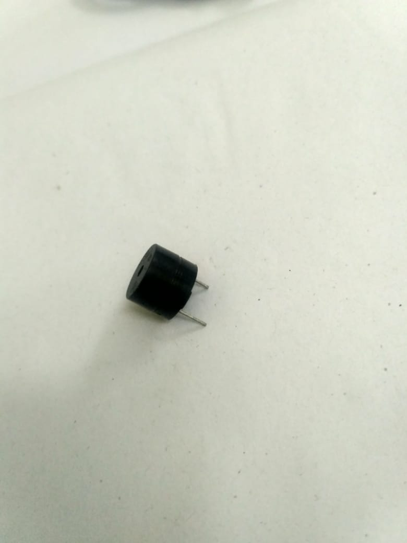
It is a device that detects the one or two types of gas in the environment.
This sensor measures the concentration of gas.
A buzzer is a audio signalling device

Slide 12
Technologies used
Embedded C
Arduino IDE
Thingspeak

Slide 13
Modules
Hardware implementation
User interface

Slide 14
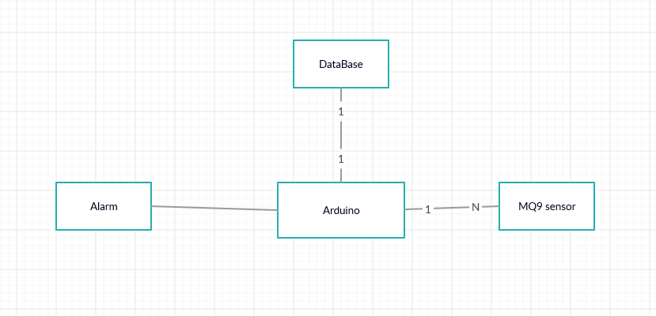
Hardware implementation

Slide 15
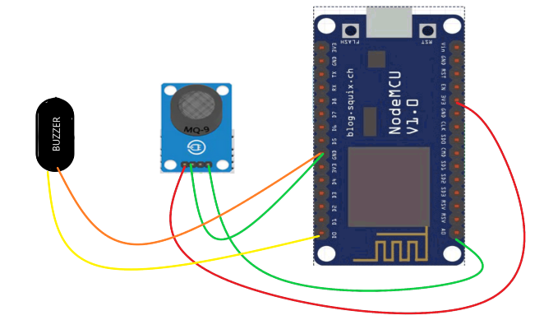
Circuit diagram

Slide 16
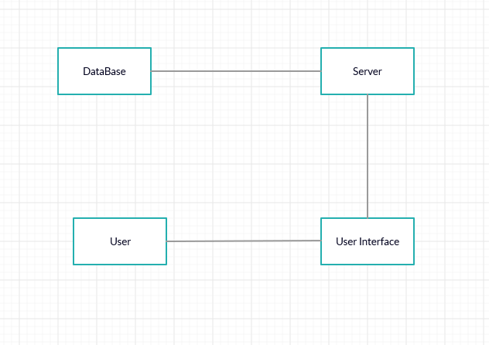
User Interface

Slide 17
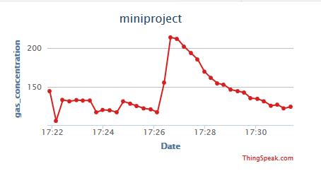


Slide 18
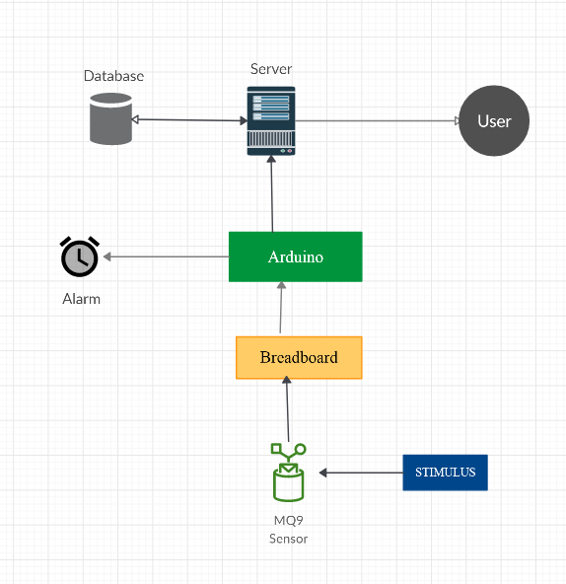
Data flow diagram

Slide 19
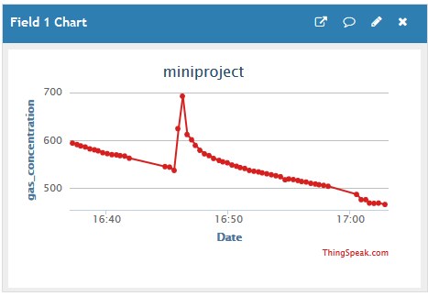
Outcome

Slide 20





Slide 21
Conclusion
Gas leakage leads to severe accidents resulting in material losses and human injuries.
Hence, leakage detection is essential to prevent accidents and to save human lives.
This is an cost efficient way to detect harmful gases. and this device is portable so can be used in Industries,home,car.

Slide 22
References
Images referenced from google images
https://en.wikipedia.org/wiki/List_of_industrial_disasters
http://www.indiaenvironmentportal.org.in/category/2543/thesaurus/gas-leakages/?page=3

Slide 23

Any queries ?

Slide 24
Thank you !

